Slide 1
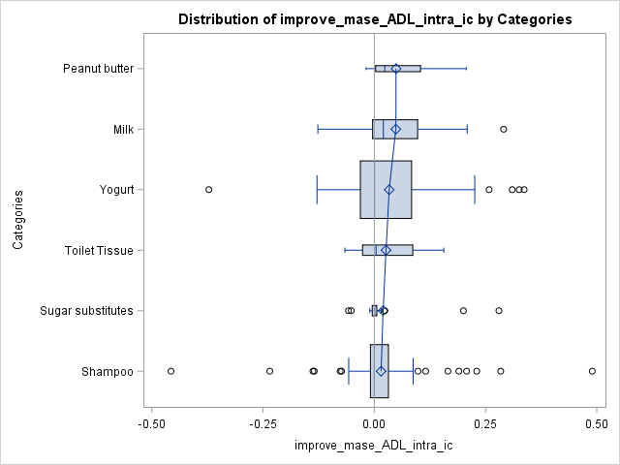
IC
Peanut butter
Milk
Yogurt
Toilet Tissue
Sugar substitutes
Shampoo
-0.4
-0.2
0
0.2
0.4

Slide 2
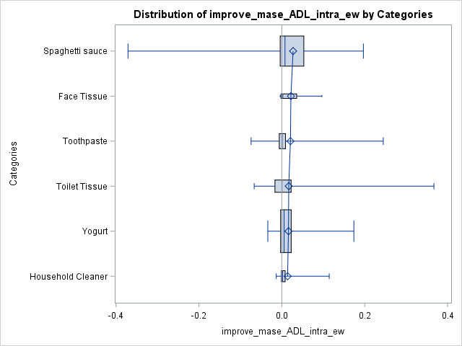
ewc
Spaghetti Sauce
Face Tissue
Toothpaste
Toilet Tissue
Yogurt
Household Cleaner
-0.4
-0.2
0
0.2
0.4

Slide 3
ewc
IC
Spaghetti Sauce
Peanut butter
Face Tissue
Milk
Toothpaste
Yogurt
Toilet Tissue
Toilet Tissue
Yogurt
Sugar substitutes
Household Cleaner
Shampoo
-40%
-20%
0
20%
40%
-40%
-20%
0
20%
40%

Slide 5
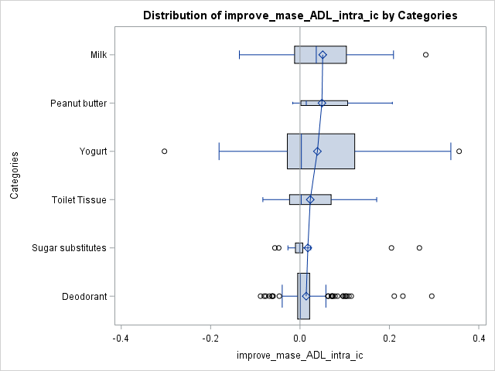
New IC
Milk
Peanut butter
Yogurt
Toilet Tissue
Sugar substitutes
Deodorant
-0.4
-0.2
0
0.2
0.4

Slide 6
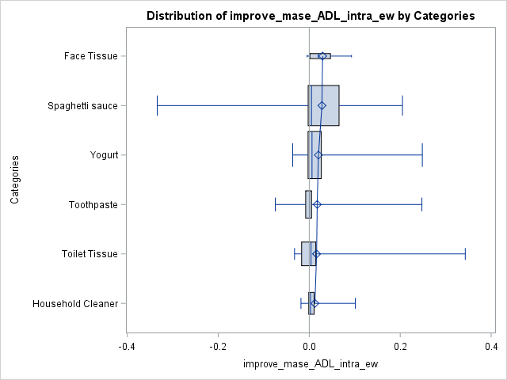
New ewc
Face Tissue
Spaghetti Sauce
Yogurt
Toothpaste
Toilet Tissue
Household Cleaner
-0.4
-0.2
0
0.2
0.4

Slide 7
Face Tissue
Milk
Spaghetti Sauce
Peanut butter
Yogurt
Yogurt
Toothpaste
Toilet Tissue
Toilet Tissue
Sugar substitutes
Household Cleaner
Deodorant
-40%
-20%
0
20%
40%
- 40%
- 20%
0
20%
40%

